Slide 1
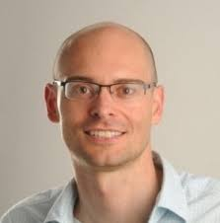
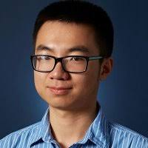
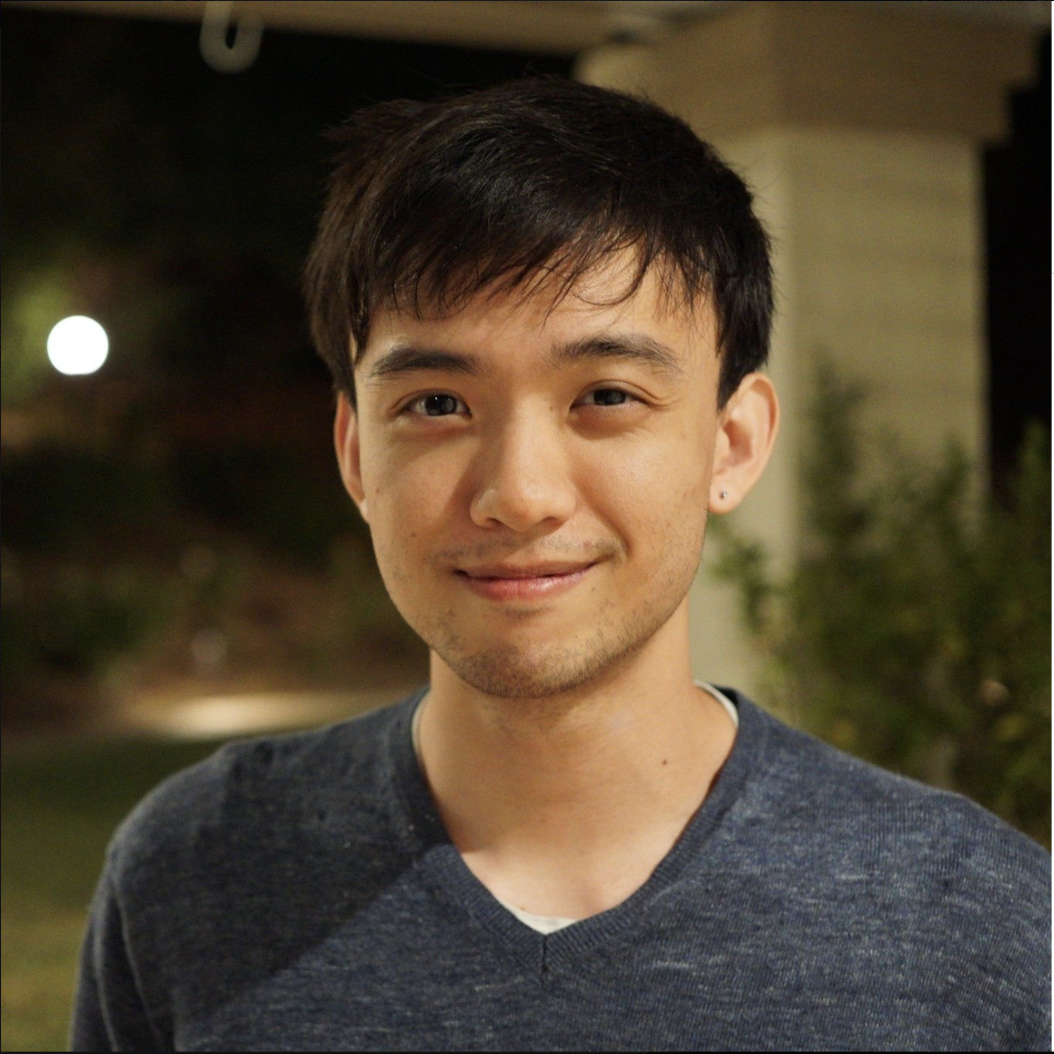
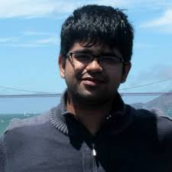
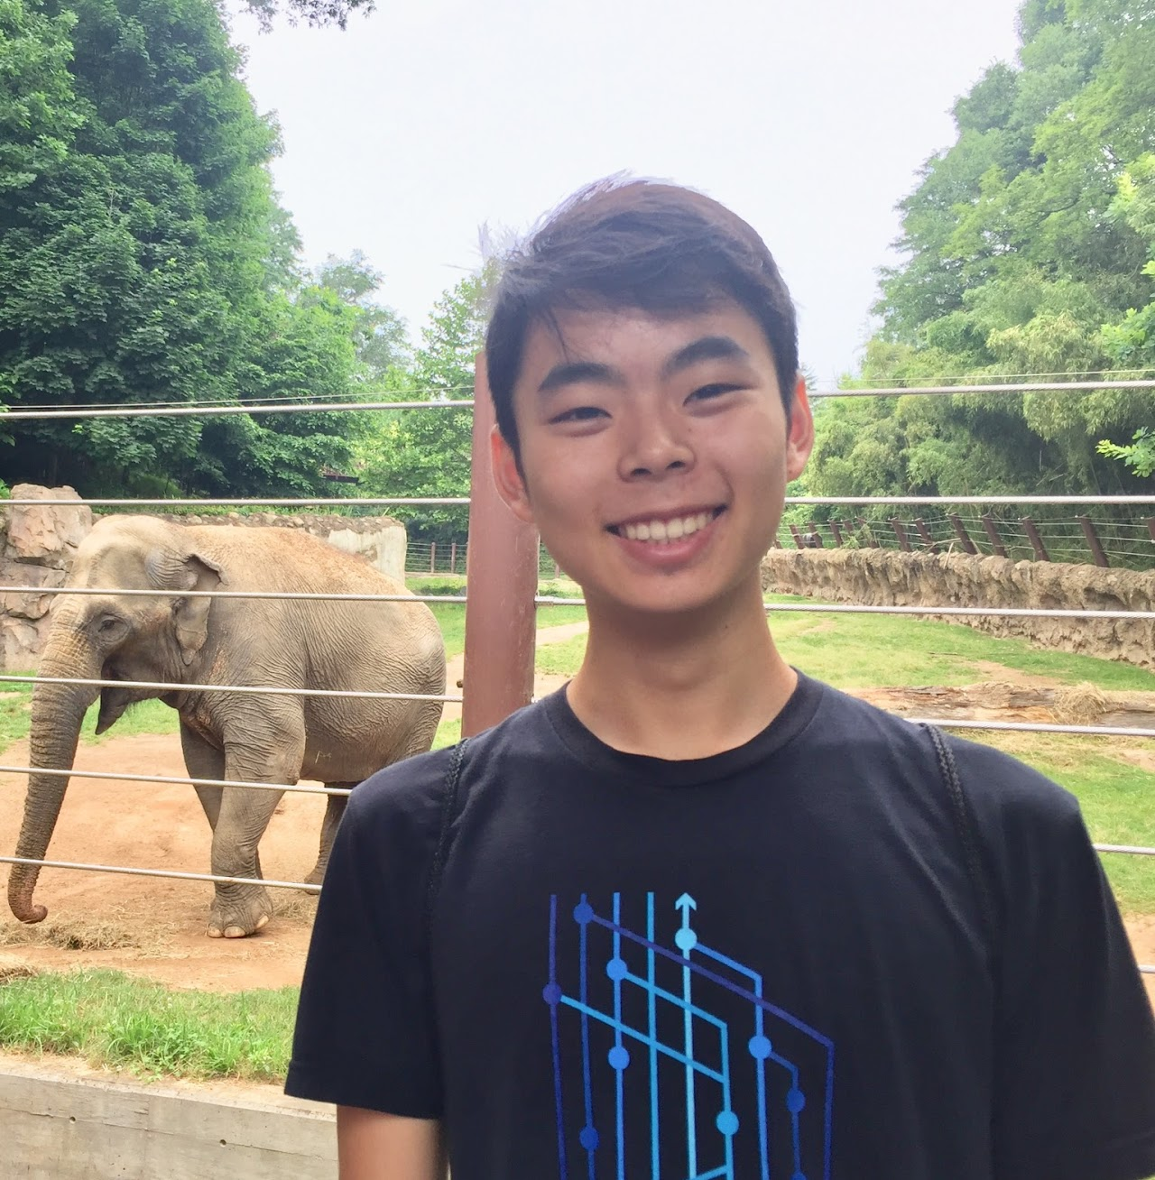
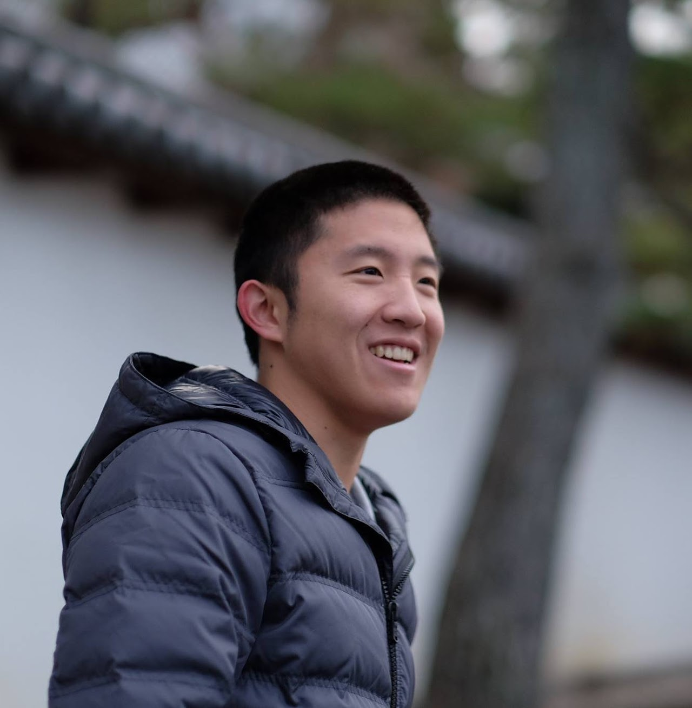
CS294-158 Deep Unsupervised Learning
Lecture 1 Intro: Logistics and Motivation
Pieter Abbeel, Xi (Peter) Chen, Jonathan Ho, Aravind Srinivas, Alex Li, Wilson Yan
UC Berkeley

Slide 2
Instructor Team
Pieter Abbeel
Xi (Peter) Chen
Jonathan Ho
Aravind Srinivas
Alex Li
Wilson Yan

Slide 3
Communication
Website: https://sites.google.com/view/berkeley-cs294-158-sp20/home
Announcements
Piazza -- sign up today!
Questions
Piazza (preferred!)
cs294-158-staff@lists.berkeley.edu
Office hours: [all starting next week]
Pieter: Thu 5-6pm -- 242 Sutardja Dai Hall
Alex: Mon 5-6pm, Tue 11-noon -- 326 Soda Hall
Wilson: Wed noon-1pm, Fri 2-3pm -- 347 Soda Hall
For homework, TA office hours are the best venue. For other questions (lecture, final project, research, etc.) any office hours should be great fits

Slide 4
Admission into the Course
Application: see website
We’ll review applications before the end of the weekend!

Slide 5
Syllabus
Week 1 (1/22) Intro
Week 2 (1/29) Autoregressive Models
Week 3 (2/5) Flow Models
Week 4 (2/12) Latent Variable Models
Week 5 (2/19) Implicit Models / Generative Adversarial Networks
Week 6 (2/26) Implicit Models / Generative Adversarial Networks (ctd) + Final Project Discussion
Week 7 (3/4) Self-Supervised Learning / Non-Generative Representation Learning
Week 8 (3/11) Self-Supervised Learning / Non-Generative Representation Learning
Week 9 (3/18) Strengths and Weaknesses of Unsupervised Learning Methods
Spring Break Week (no lecture)
Week 10 (4/1) Semi-Supervised Learning; Unsupervised Distribution Alignment
Week 11 (4/8) Compression
Week 12 (4/15) Language Models
Week 13 (4/22) Midterm
Week 14 (4/29) Representation Learning in Reinforcement Learning
Week 15 (5/6) RRR Week (no lecture)
Week 16 (5/13) Final Project Presentations + Final Project Reports due

Slide 6
Homework
HW1: Autoregressive Models (out 1/29, due 2/11)
HW2: Flow Models (out 2/12, due 2/25)
HW3: Latent Variable Models (out 2/26, due 3/10)
HW4: Implicit Models / GANs (out 3/11, due 3/31)

Slide 7
Homework Policy
Collaboration: Students may discuss assignments. However, each student must code up and write up their solutions independently.
Late assignments: Recognizing that students may face unusual circumstances and require some flexibility in the course of the semester, each student will have a total of 7 free late (calendar) days to use as s/he sees fit, but no more than 4 late days can be used on any single assignment. Late days are counted at the granularity of days: e.g., 3 hours late is one late day.

Slide 8
Midterm
Date: 4/22 (during lecture slot)
Topics: everything covered through (and including) 4/15
Format: we will provide a document with questions and answers ahead of time (~20)
Rationale: opportunity to force yourself to fully internalize key derivations and concepts

Slide 9
Final Project
SCOPE:
Goal: explore and push the boundaries in unsupervised learning.
E.g. proposal+evaluation of new algorithms / architectures, investigation of an application of unsupervised learning, benchmarking unsupervised learning, compression, studying synergies between unsupervised learning and other types of learning, etc.
Ideally, the project covers interesting new ground and might be the foundation for a future conference paper submission or product.
PROJECT TOPICS / STAFF INPUT:
We encourage trying to come up with your own project idea. We are also happy to make suggestions and/or brainstorm ideas together.
One of the main reasons we are so excited to teach this class is to see more Deep Unsupervised Learning projects happen. We are very excited to advise on your projects, please don't hesitate to come to office hours to discuss project ideas, project progress, ideas for next steps, etc.

Slide 10
Final Project -- Timeline
- March 2nd Project Proposals Due: 1 page description of project + goals for milestone. -- Submission through google doc shared with instructors, so we can give feedback/suggestions most easily.
- March 9th Approved Project Proposals Due: by this time your proposals should have incorporated instructor feedback, at this stage it should be assured that your proposal is of right fit and scope
- April 13th 3-Page Milestone Due: This is to make sure you are indeed making progress on the project and an opportunity to get feedback on your progress thus far, as well as on any revisions you might want to propose to your project goals. Expectation is that you report on some initial experimental findings (or if you are doing something purely theoretical, some initial progress on that front). -- Submission through google doc shared with instructors, so we can give feedback/suggestions most easily.
- May 13th Project Presentations: 250 SDH, 5-8pm (same as lecture slot)
- May 15th 6-Page Final Project Reports Due

Slide 11
Grading Logistics
60% Homework
10% Midterm
30% Final Project

Slide 12
Do we need to attend class?
No hard requirement
BUT: very highly recommended
Great opportunity to get to know other students at Berkeley embarking on Deep Unsupervised Learning
Pizza!

Slide 13
WARNING
Second offering of this course
There will be some rough edges, please bear with us
+ give feedback!

Slide 14
What is Deep Unsupervised Learning?
Capturing rich patterns in raw data with deep networks in a label-free way
Generative Models: recreate raw data distribution
Self-supervised Learning: “puzzle” tasks that require semantic understanding
But why do we care?

Slide 15
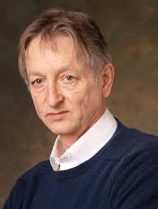
“The brain has about 10^14 synapses and we only live for about 10^9 seconds. So we have a lot more parameters than data. This motivates the idea that we must do a lot of unsupervised learning since the perceptual input (including proprioception) is the only place we can get 10^5 dimensions of constraint per second.”
Geoffrey Hinton
(in his 2014 AMA on Reddit)

Slide 16
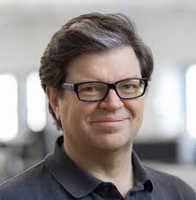
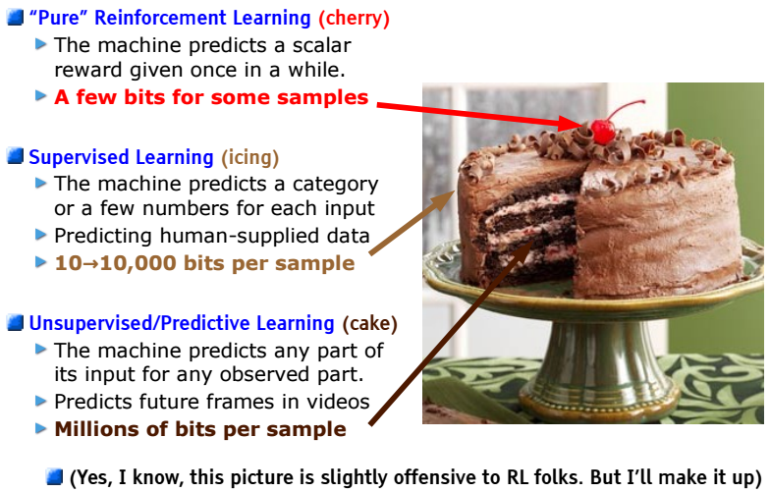
LeCake
Yann LeCun
Need tremendous amount of information to build machines that have common sense and generalize
[LeCun-20161205-NeurIPS-keynote]
Notes:
A caveat with the bits argument: Not all bits are equal. Supervised Learning and Reinforcement Learning bits are much more “useful” bits than unsupervised raw input “bits”.

Slide 17
“Ideal Intelligence”
“Ideal Intelligence” is all about compression (finding all patterns)
Finding all patterns = short description of raw data (low Kolmogorov Complexity)
Shortest code-length = optimal inference (Solomonoff Induction)
Extensible to optimal action making agents (AIXI)

Slide 18
Aside from theoretical interests
Deep Unsupervised Learning has many powerful applications
Generate novel data
Conditional Synthesis Technology (WaveNet, GAN-pix2pix)
Compression
Improve any downstream task with un(self)supervised pre-training
Production level impact: Google Search powered by BERT
Flexible building blocks

Slide 19
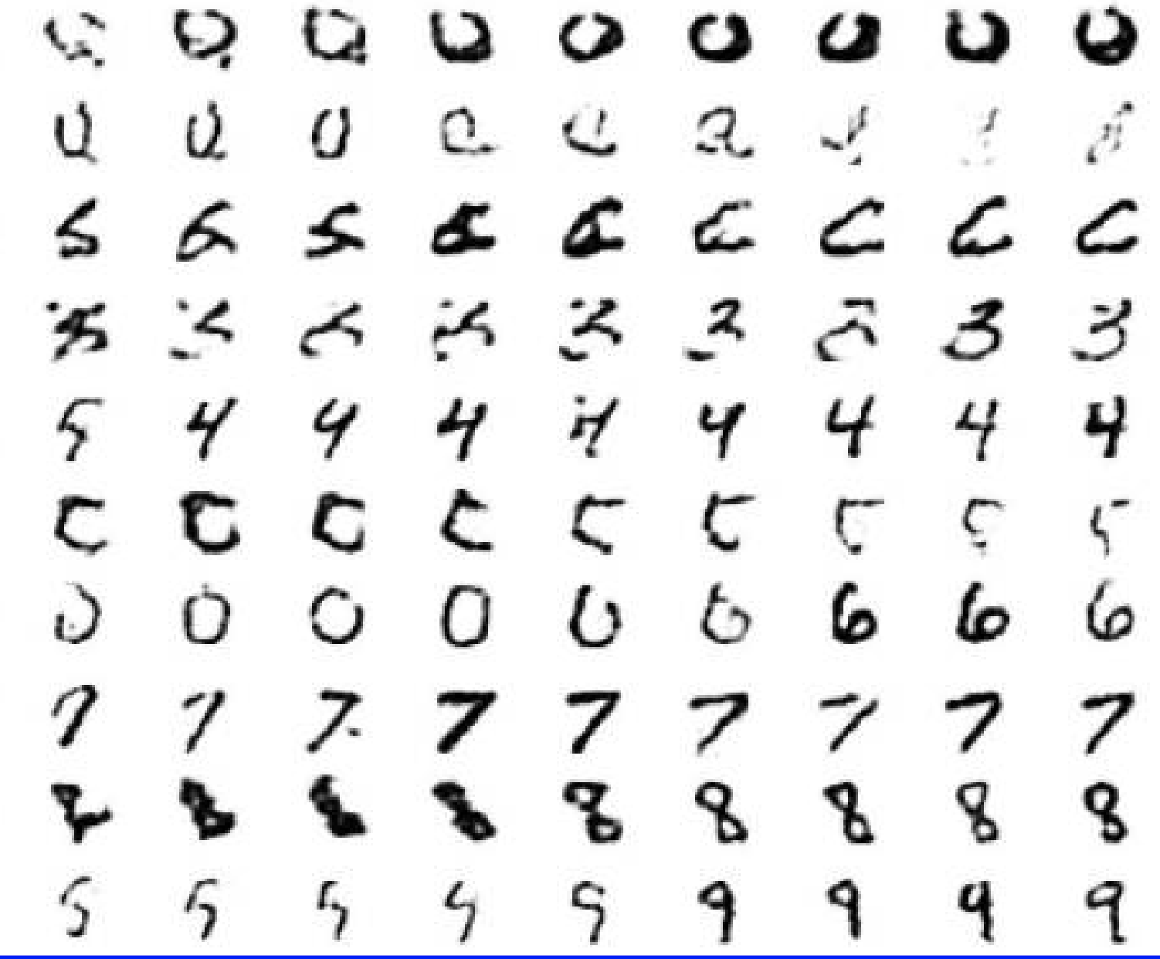
Generate Images
[Deep Belief Nets, Hinton, Osindero, Teh, 2006]

Slide 20
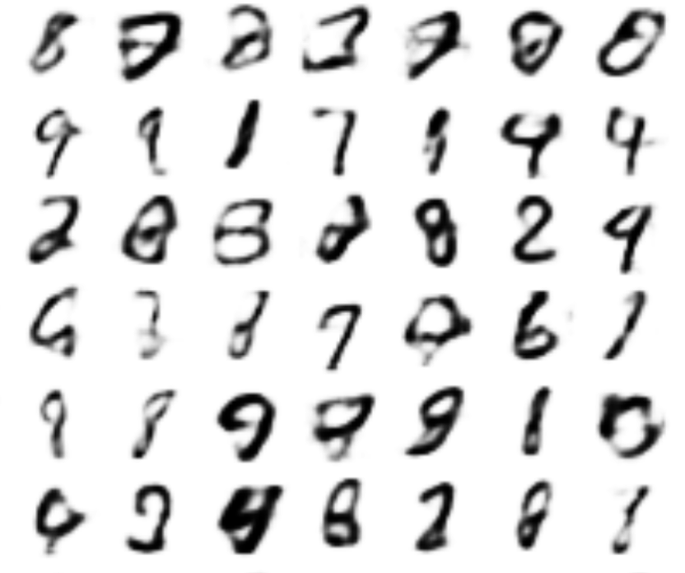
Generate Images
[VAE, Kingma and Welling, 2013]

Slide 21
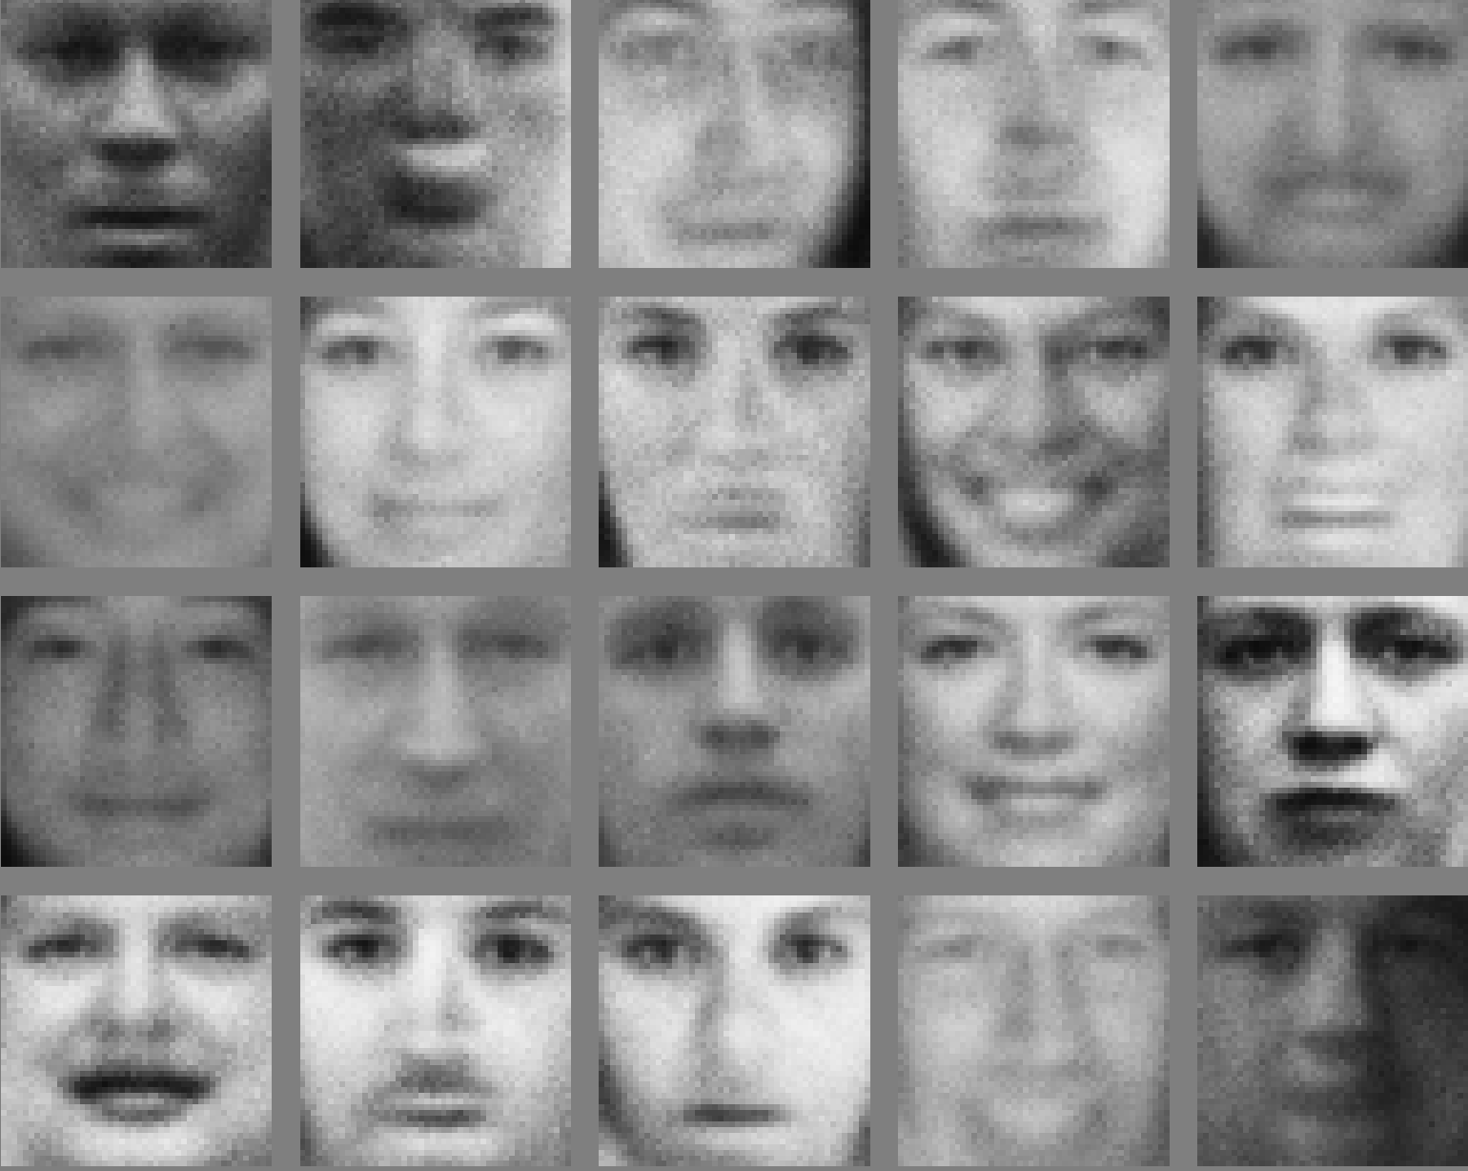
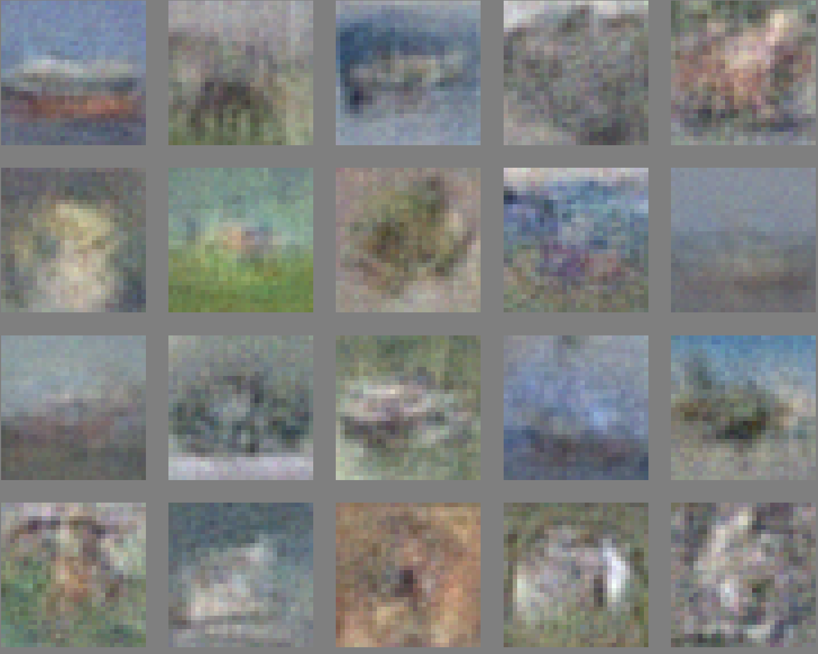
Generate Images
[GAN, Goodfellow et al. 2014]

Slide 22
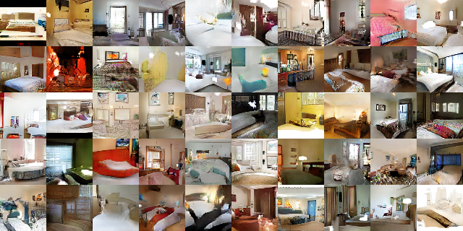
Generate Images
[DCGAN, Radford, Metz, Chintala 2015]

Slide 23
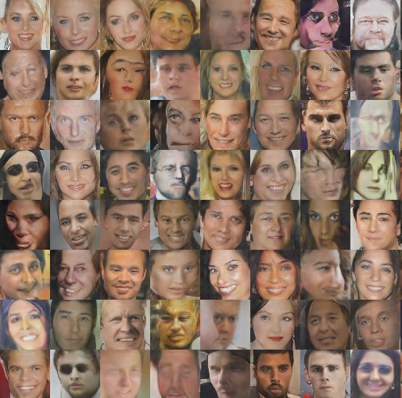
Generate Images
[DCGAN, Radford, Metz, Chintala 2015]

Slide 24
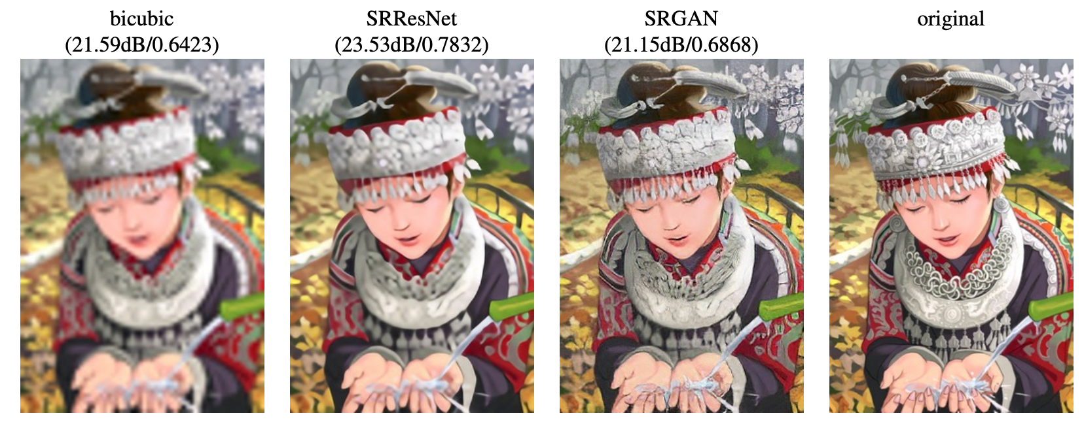
Generate Images
[Ledig, Theis, Huszar et al, 2017]

Slide 25

Generate Images
[CycleGAN: Zhu, Park, Isola & Efros, 2017]

Slide 26
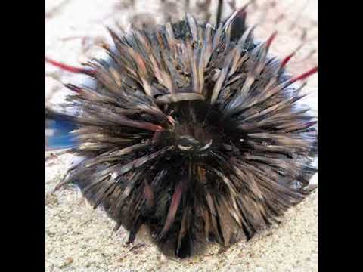
Generate Images
[BigGAN, Brock, Donahue, Simonyan, 2018]

Slide 27
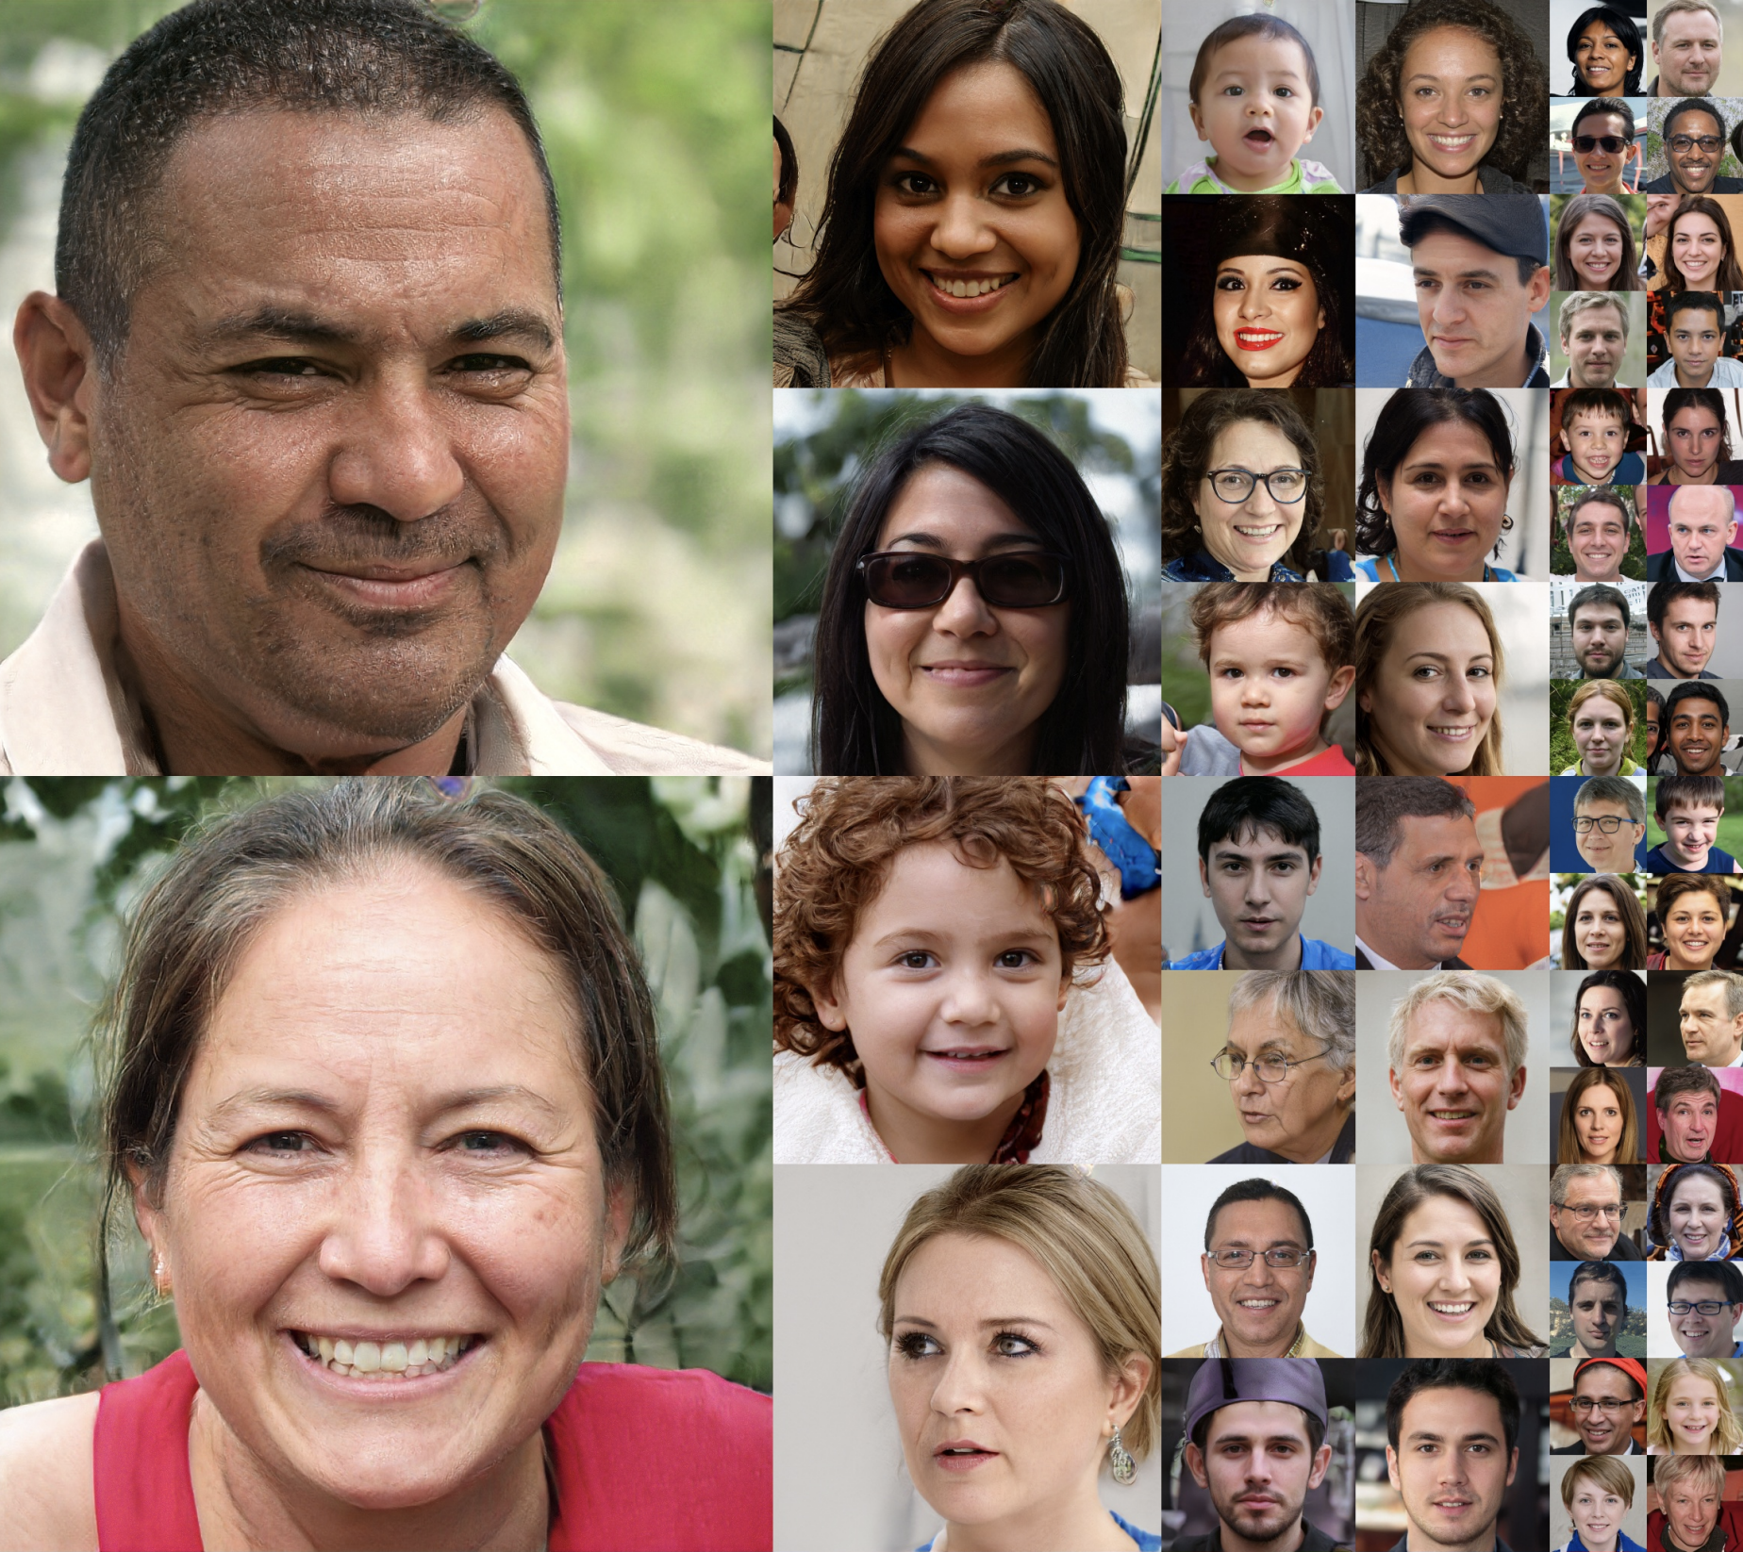
Generate Images
[StyleGAN, Karras, Laine, Aila, 2018]

Slide 28
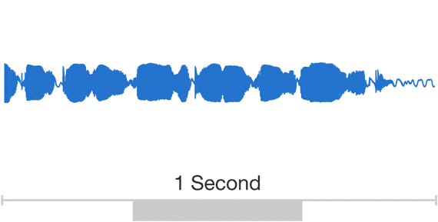
Generate Audio
Parametric
WaveNet
[WaveNet, Oord et al., 2018]

Slide 29
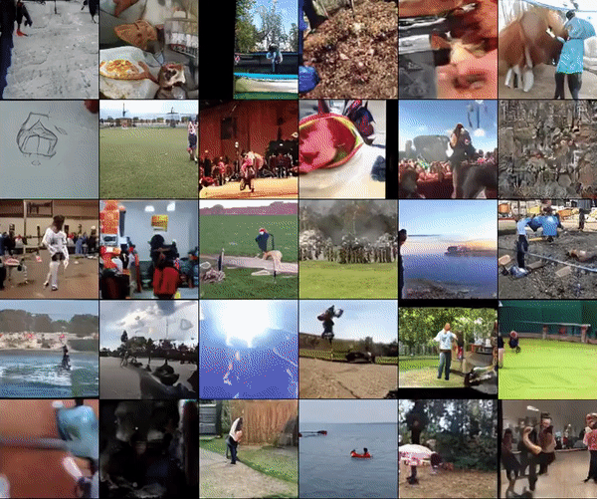
Generate Video
DVD-GAN: Adversarial Video Generation on Complex Datasets, Clark, Donahue, Simonyan, 2019

Slide 30
Generate Text
PANDARUS: Alas, I think he shall be come approached and the day When little srain would be attain'd into being never fed, And who is but a chain and subjects of his death, I should not sleep. Second Senator: They are away this miseries, produced upon my soul, Breaking and strongly should be buried, when I perish The earth and thoughts of many states. DUKE VINCENTIO: Well, your wit is in the care of side and that.
[Char-rnn, karpathy, 2015]

Slide 31
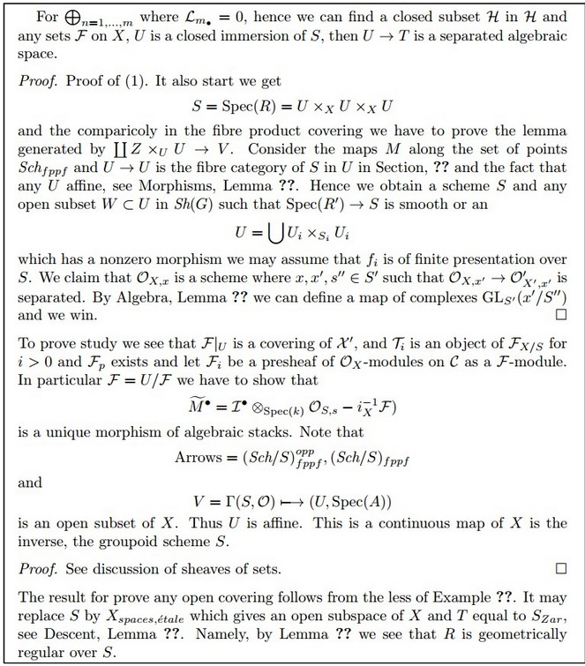
Generate Math
\begin{proof} We may assume that $\mathcal{I}$ is an abelian sheaf on $\mathcal{C}$. \item Given a morphism $\Delta : \mathcal{F} \to \mathcal{I}$ is an injective and let $\mathfrak q$ be an abelian sheaf on $X$. Let $\mathcal{F}$ be a fibered complex. Let $\mathcal{F}$ be a category. \begin{enumerate} \item \hyperref[setain-construction-phantom]{Lemma} \label{lemma-characterize-quasi-finite} Let $\mathcal{F}$ be an abelian quasi-coherent sheaf on $\mathcal{C}$. Let $\mathcal{F}$ be a coherent $\mathcal{O}_X$-module. Then $\mathcal{F}$ is an abelian catenary over $\mathcal{C}$. \item The following are equivalent \begin{enumerate} \item $\mathcal{F}$ is an $\mathcal{O}_X$-module. \end{lemma}
[Char-rnn, karpathy, 2015]

Slide 32
Generate Text
Prompt [human written]: A train carriage containing controlled nuclear materials was stolen in Cincinnati today. Its whereabouts are unknown.
GPT-2: The incident occurred on the downtown train line, which runs from Covington and Ashland stations. In an email to Ohio news outlets, the U.S. Department of Energy said it is working with the Federal Railroad Administration to find the thief.
‘The theft of this nuclear material will have significant negative consequences on public and environmental health, our workforce and the economy of our nation,’ said Tom Hicks, the U.S. Energy Secretary, in a statement. ‘Our top priority is to secure the theft and ensure it doesn’t happen again.’
The stolen material was taken from the University of Cincinnati’s Research Triangle Park nuclear research site, according to a news release from Department officials.
The Nuclear Regulatory Commission did not immediately release any information. According to the release, the U.S. Department of Energy’s Office of Nuclear Material Safety and Security is leading that team’s investigation.
‘The safety of people, the environment and the nation’s nuclear stockpile is our highest priority,’ Hicks said. ‘We will get to the bottom of this and make no excuses.’
[OpenAI’s GPT2 -- Radford, Wu, Child, Luan, Amodei, Sutskever, 2019]

Slide 33
Generate Text
Prompt (human written): Recycling is good for the world, no, you could not be more wrong.
GPT-2: Recycling is NOT good for the world. It is bad for the environment, it is bad for our health, and it is bad for our economy. I’m not kidding. Recycling is not good for the environment. It is destructive to the earth and it is a major contributor to global warming. Recycling is not good for our health. It contributes to obesity and diseases like heart disease and cancer. Recycling is bad for our economy. It increases the cost of a product, and in turn, the price of everything that is made with that product. Recycling is not good for our nation. We pay a tremendous price for the privilege of having the world’s most advanced and efficient recycling system. Recycling is a huge, colossal waste of time, energy, money, and resources.
[OpenAI’s GPT2 -- Radford, Wu, Child, Luan, Amodei, Sutskever, 2019]

Slide 34
Try it yourself
https://talktotransformer.com/

Slide 35
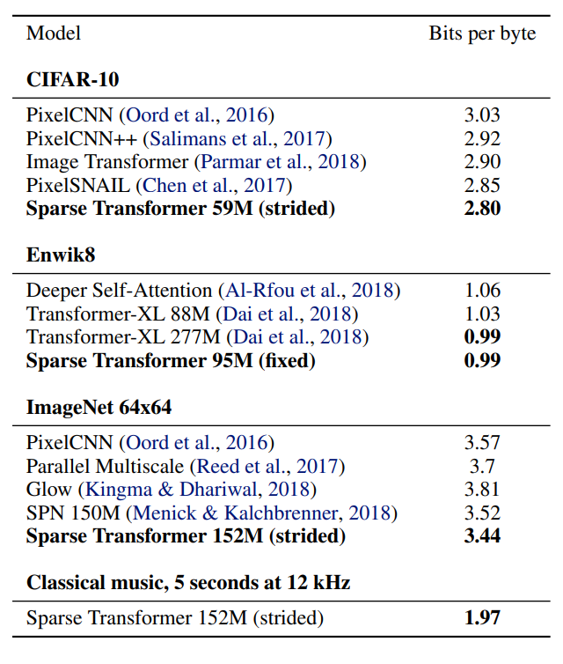
Compression - Lossless
Generative models provide better bit-rates than distribution-unaware compression methods like JPEG, etc.

Slide 36
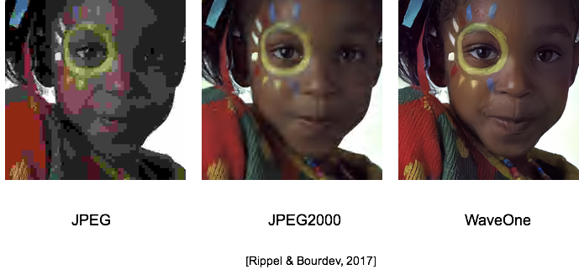
Compression - Lossy

Slide 37
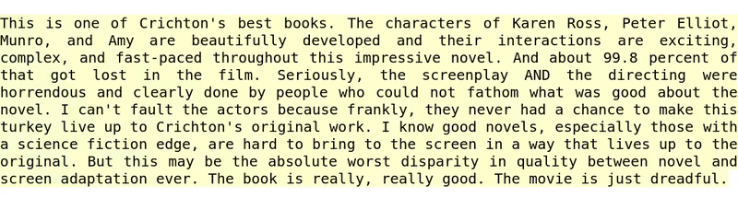
Downstream Task - Sentiment Detection
[Radford et al., 2017]

Slide 38
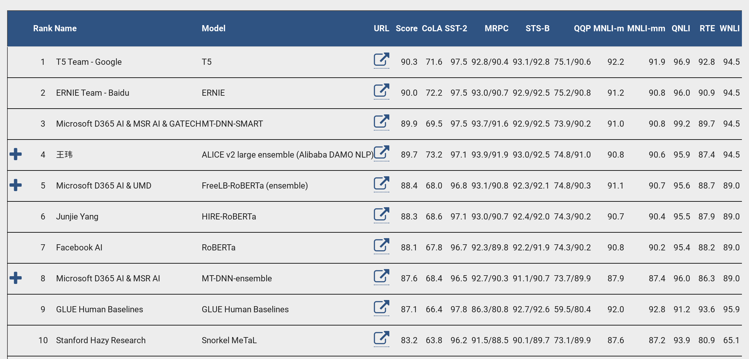
Downstream Tasks - NLP (BERT Revolution)
[https://gluebenchmark.com/leaderboard]

Slide 39
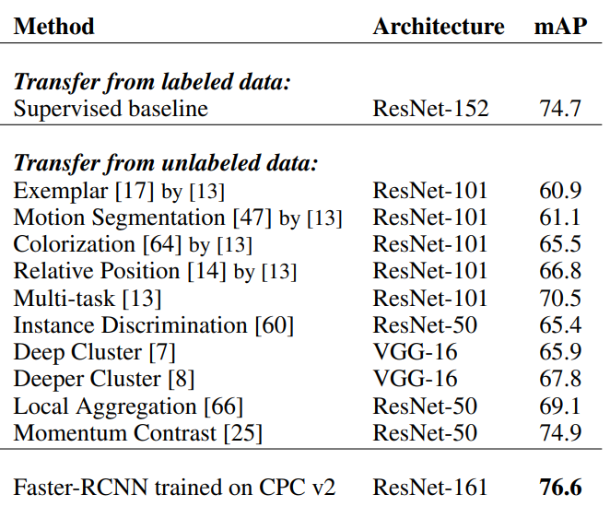
Downstream Tasks - Vision (Contrastive)
"If, by the first day of autumn (Sept 23) of 2015, a method will exist that can match or beat the performance of R-CNN on Pascal VOC detection, without the use of any extra, human annotations (e.g. ImageNet) as pre-training, Mr. Malik promises to buy Mr. Efros one (1) gelato (2 scoops: one chocolate, one vanilla)."
Table: Data-Efficient Image Recognition using CPC (Henaff, Srinivas, et al)

Slide 40
Summary
Unsupervised Learning: Rapidly advancing field thanks to compute; deep learning engineering practices; datasets; lot of people working on it.
Not just an academic interest topic. Production level impact [example: BERT is in use for Google Search and Assistant].
What is true now may not be true even a year from now [example: self-supervised pre-training was way worse than supervised in computer vision tasks like detection/segmentation last year. Now it is better].
Language Modeling (GPT), Image Generation (conditional GANs), Language pre-training (BERT), vision pre-training (CPC / MoCo) starting to work really well. Good time to learn these well and make very impactful contributions.
Autoregressive Density Modeling, Flows, VAEs, UL for RL, etc have huge room for improvement. Great time to work on them.

